Slide 1

Conversational
OOM Killer
Team RSP
👑노혁준 백선하 이승원 강규현 이유진
2026 1st semester kus-operating-system project

Slide 2

The Problem
Out of memory, the OS must kill a process. But how does it choose?
Scenario: You are coding in VS Code (2 GB) with an idle Chrome (2.5 GB) in the background.
Default OOM Killer
What the user actually wants
Picks the biggest by oom_score
"Never kill VS Code - Chrome is fine."
-> kills VS Code (your work!)
-> should kill Chrome
The kernel decides by size - user intent is never part of the decision.

Slide 3


1
Write
User writes priorities in plain natural language - no config files.
2
Interpret
On memory pressure, an LLM (Solar Pro, temp = 0) reads the policy and returns victims as JSON
Approach
3
Validate
A deterministic C validator protects system processes - the final gate
KEY IDEA
The LLM only suggests
- the OS makes the final decision.

Slide 4
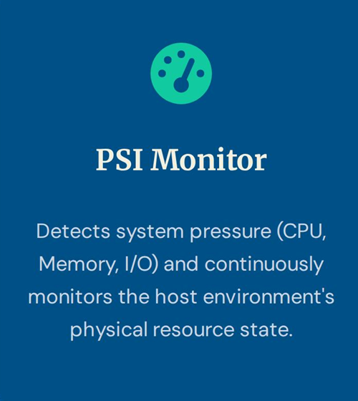
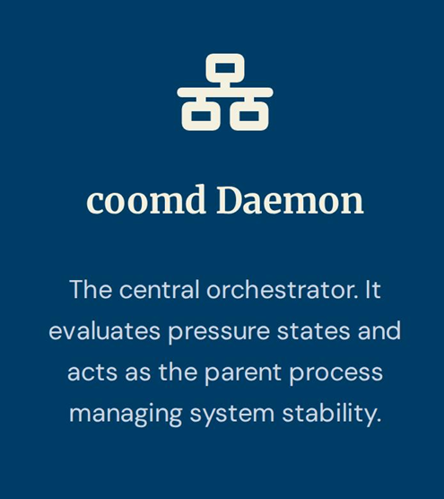
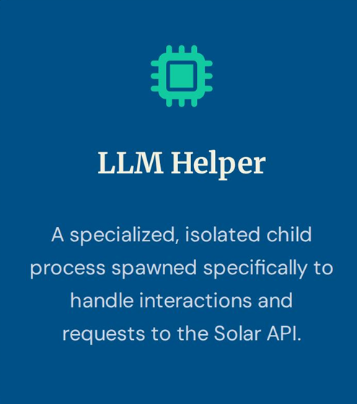
Architecture
PSI detects pressure -> coomd collects /proc candidates -> LLM picks victim (JSON via pipe) -> Validator checks -> SIGTERM -> SIGKILL

Slide 5
Tech Stack
Three stages, one pipeline - C does the OS work, the LLM just advises.
Daemon
LLM Helper
xv6 Kernel
written in C
written in Python
xv6-riscv · QEMU
Main loop + policy load
fork + exec -> Python
pipe + dup2 (JSON IPC)
SIGTERM -> SIGKILL
Validator guards every kill
→
Upstage Solar Pro
temperature = 0
JSON response mode
Mock fallback if no key
one-shot stdin -> stdout
→
PSI in kalloc.c
sleep / wakeup on alloc
EMA every timer tick
4 new syscalls
some_avg10 0% -> 9%
OS mechanisms in action: fork · exec · pipe · signals · /proc · PSI · waitpid

Slide 6
OS Concepts in Action
Where each operating-system concept from the course actually lives in our system.
OS Concept | Where it is used in our system | Mechanism / call
Process creation | C daemon spawns the Python LLM helper | fork() + execlp()
IPC | bidirectional C <-> Python, JSON | pipe() + dup2()
Signals | terminate the chosen victim | kill(): SIGTERM -> SIGKILL
Process lifecycle | reap the helper child (no zombies) | waitpid(WNOHANG)
Memory pressure | detect low-memory condition | /proc/pressure/memory (PSI)
/proc filesystem | collect candidate processes | readdir + /proc/[pid]/status
Virtual memory | xv6: track stalls on page alloc | kalloc / kfree + sleep/wakeup
Synchronization | xv6: avoid recursive lock | release lock before kalloc
System calls | xv6: expose stats to userspace | 4 new syscalls
The LLM is one HTTPS call. Everything around it is real OS code.

Slide 7

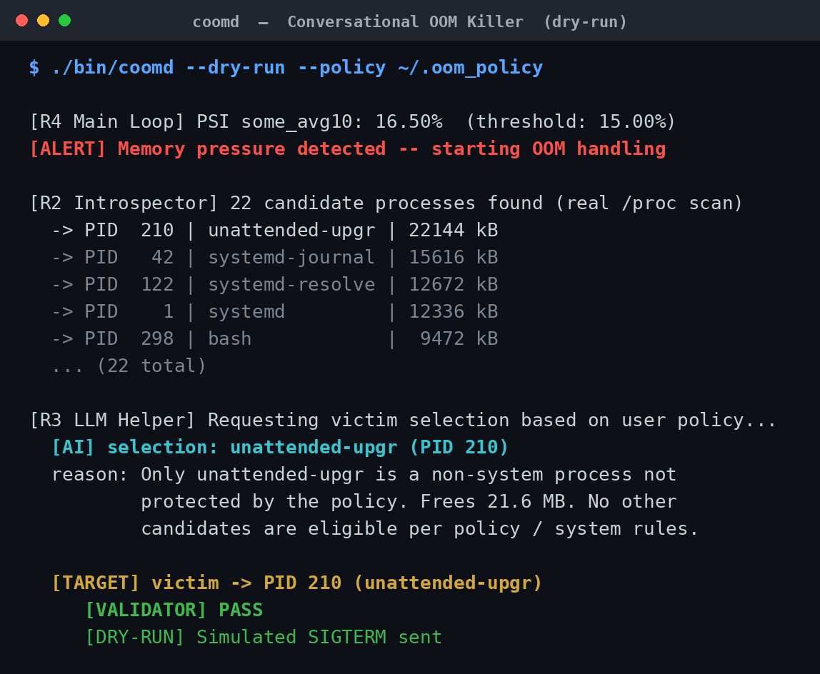
Demo - One Scenario, End to End
1
User policy
"I am coding. Never kill VS Code or firefox. Chrome is fine to kill."
2
Real candidates (from/proc)
chrome 1200 MB
firefox 800 MB (protected)
code 600 MB (protected)
systemd 12 MB (system)
3
AI decision
-> kill chrome VALIDATOR PASS

Slide 8

Why “Conversational”?
Same machine. Same processes. Same memory. Only the words change.
Candidates: chrome (1.2 GB) · spotify (400 MB) · code (600 MB)
“kill chrome”
kills chrome
“save chrome, kill spotify instead”
kills spotify
The decision flipped – because the OS listened to you.
That is Conversational

Slide 9
Evaluation
5 scenarios · 6 decisions · isolated LLM helper invocation
# | Policy (key idea) | AI Selection | OK
1 | Protect firefox / code; chrome OK | chrome | ✓
2 | music < browser < editor priority | spotify + chrome | ✓
3 | Protect abstract 'system processes' | chrome (sys avoided) | ✓
4 | Protect everything | (refused) | ✓
5a | 'Kill chrome' | chrome | ✓
5b | 'Save chrome, kill spotify' | spotify | ✓
100%
100%
policy compliance
policy compliance
Scenario 4
Refused to kill when policy conflicts with the memory goal - safety first.
Scenario 5
Same state, changed policy -> opposite decision. That is conversational.

Slide 10
xv6 Kernel - PSI Inside
We modified the kernel itself - not a layer on top.
Kernel changes
Kernel API + result
Real edits to xv6-riscv source
Exposed to userspace, measured in QEMU
kalloc.c
sleep when a page alloc fails
record mem_stall_ticks
kfree.c
wakeup waiters on free
trap.c
timer tick -> update_psi() (EMA)
-> PSI computed entirely in-kernel
4 new syscalls:
sys_get_mem_pressure
sys_get_sys_stat
sys_get_proc_stats
sys_get_oom_candidates
Stress test (QEMU):
some_avg10 0% -> 9%, stable
-> real-time pressure visible
Lock safety: proc lock released before kalloc in allocproc / kfork - real kernel debugging.

Slide 11
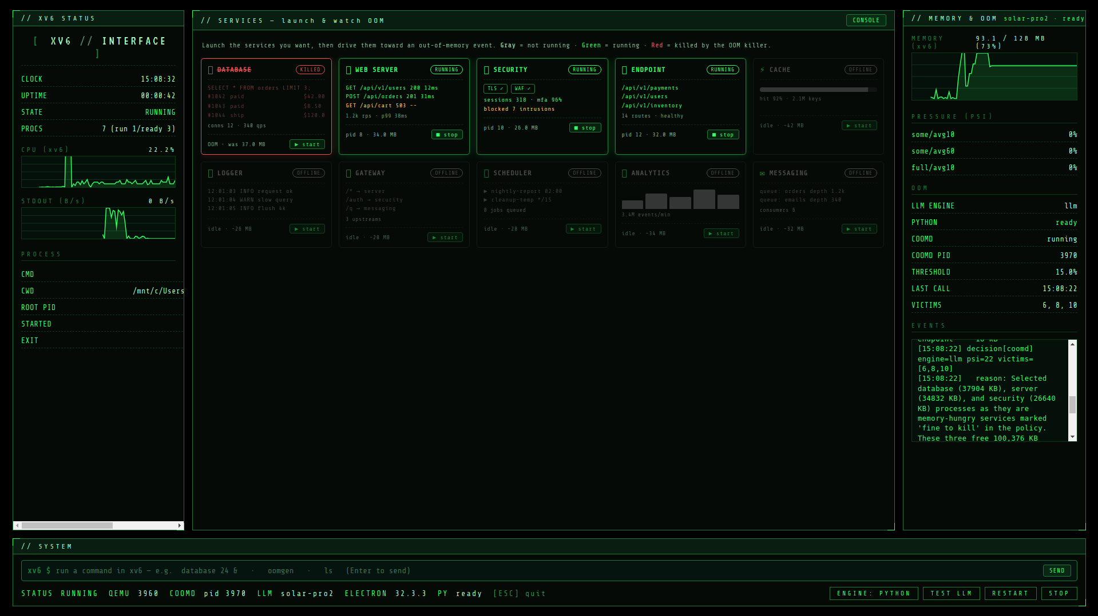
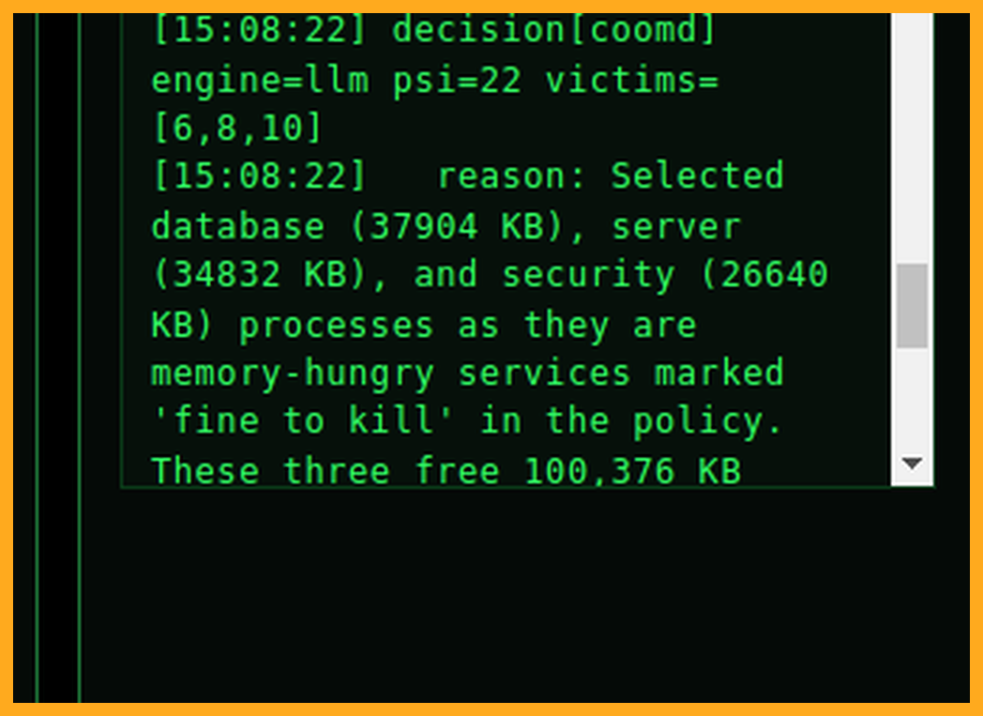
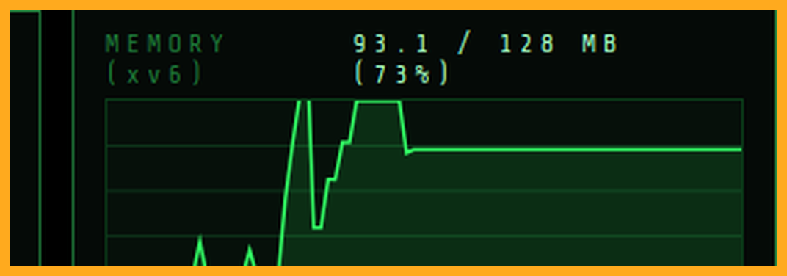
xv6 Live Monitor - OOM in action
Real services workload, real Solar Pro, real-time decision - captured live in the xv6 monitor.
1 POLICY (input)
Fine to kill: memory-hungry services
(e.g. database, server, security)
Keep alive: critical services
(cache, gateway, endpoint…)
2 AI DECISION
AI decision (events log)
Memory change
Killed: database + server
+ security
Protected: cache · gateway · scheduler ·
Violations: zero
3 RESULT
Memory freed
~100 MB · 3 services killed
Live xv6 monitor — services running, AI killed three to free memory.
The same idea, proven in userspace AND inside the kernel.

Slide 12
Limitations
Honest about what works -- and what is still being hardened.
01
LLM latency
Inference adds 1-2 s per decision;
PSI triggers early to buy time.
-> local models could help
02
xv6 robustness
Core path verified (some_avg10 0 -> 9%);
full_avg10 + edge cases still hardening.
-> heavy-load stability WIP
03
Edge cases
One LLM arithmetic slip (victim still correct);
adversarial policies need more testing.
-> Validator is the backstop
Safety net: the deterministic C Validator catches any bad LLM pick.

Slide 13
Team Roles
ORCHESTRATOR
PSI Monitor
LLM Helper
PSI event
coomd daemon
pipe (JSON)
reads /proc/
pressure/memory
Python · Solar API
C · validator · signals
R1 · 강규현
R4 · 백선하
R3 · 이승원
R2 · 이유진 /proc Reader — collects real process candidates R5 · 노혁준 Integration testing & evaluation
OS concepts: fork + exec + pipe (process creation & IPC), signals (SIGTERM->SIGKILL), PSI & /proc — a real OS design, not just an API call.

Slide 14
Thank you
Conversational OOM Killer · Team RSP

